Slide 1
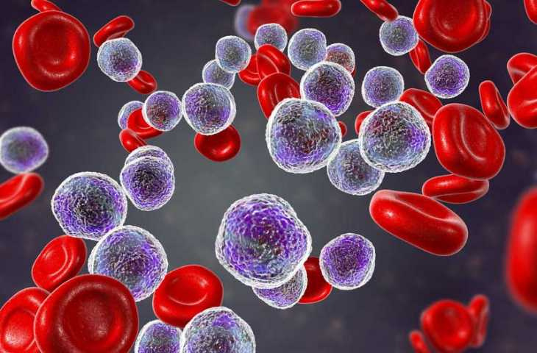
BIM444
COMPUTER ENGINEERING APPLICATIONS
CLASSIFICATION MODELS FOR THE DIAGNOSIS OF ACUTE LYMPHOBLASTIC LEUKEMIA
Advisor: Assist. Prof. Dr. Selcan K. B.
Mechmet C. C.
Ali Han O.
Koray K.

Slide 2

PRESENTATION OUTLINE
- Introduction
- What is Acute Lymphoblastic Leukemia ?
- Research's/Project's Value
- Aims & Goals
- Process
- Datasets
- Methods
Preprocessing & Augmentation Techniques
Convolutional Neural Networks
Transfer Learning
K-Fold Cross Validation
Ensemble Learning
- Experimental Results
- Conclusion

Slide 3
Introduction
We are a group of dedicated individuals who have come together to work on an exciting project. Utilizing Medical Image Processing, our effort focuses on the detection(classification) of Acute Lymphoblastic Leukemia using microscopic blood images.

Slide 4
What is Leukemia ?
Leukemia is a type of cancer that affects the blood cells, specifically the white blood cells. Leukemia is classified based on the type of blood cells that are affected and the rate at which the cancer cells multiply.
There are four main types of leukemia:
Acute Lymphoblastic Leukemia (ALL)
Acute Myeloid Leukemia (AML)
Chronic Lymphocytic Leukemia (CLL)
Chronic Myeloid Leukemia (CML)
In our studies we focuses on Acute Lymphoblastic Leukemia (ALL) which tends to progress rapidly and is typically more aggressive.

Slide 5
What is Acute Lymphoblastic Leukemia ?
Acute lymphoblastic leukemia (ALL) is a type of cancer that affects the white blood cells, which are an important part of the immune system. In ALL, the bone marrow produces abnormal white blood cells called lymphoblast, which are immature cells that are unable to function properly. These abnormal cells multiply rapidly and crowd out the normal cells in the bone marrow, leading to a decrease in healthy white blood cells, red blood cells, and platelets.

Slide 6
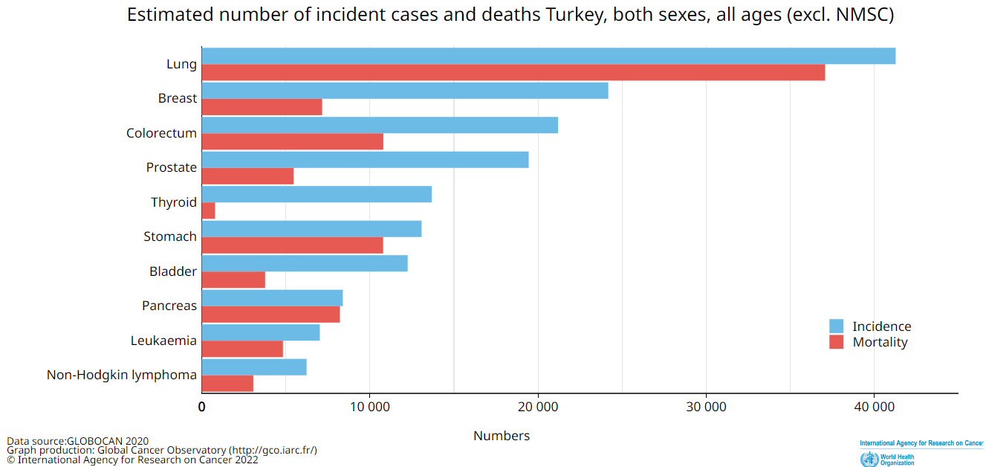
Research's/Project's Value
Notes:
In our country, an average of 7000 citizens mostly children are diagnosed with leukemia every year. According to the latest WHO data published in 2020 Leukemia Deaths in Turkey reached 4,800 or 1.25% of total deaths. The age adjusted Death Rate is 5.60 per 100,000 of population, Turkey ranks number 13 in the world. By diagnosing leukemia more quickly and accurately, this study hopes to assist potential patients of these illnesses.

Slide 7
Research's/Project's Value
Manual methods of leukemia diagnosis are heavily used, but they are unreliable, time-consuming and labor-intensive. Manual methods can also be affected by the medical personnel's state. The project aims to create a computer-aided system using image processing and deep learning to assist in diagnosing Acute Lymphoblastic Leukemia and increase accuracy by providing a second opinion to the medical personal to eliminate human error.

Slide 8
Research's/Project's Value
The main purpose of the project is to develop a computer-aided diagnosis system that can assist experts in diagnosing Acute Lymphoblastic Leukemia with various image processing and deep learning techniques to facilitate and accelerate the detection of whether a person is healthy or not. It is aimed to increase the accuracy of the diagnosis by providing a second opinion in order to eliminate human errors.

Slide 9



Aims & Goals
Providing a second opinion in order to eliminate the physiological factors that may affect the diagnosis made by the healthcare professionals.
Contribute to the literature by trying untested methods and increasing the success rate of ALL Classification.
Help to save lives!

Slide 10
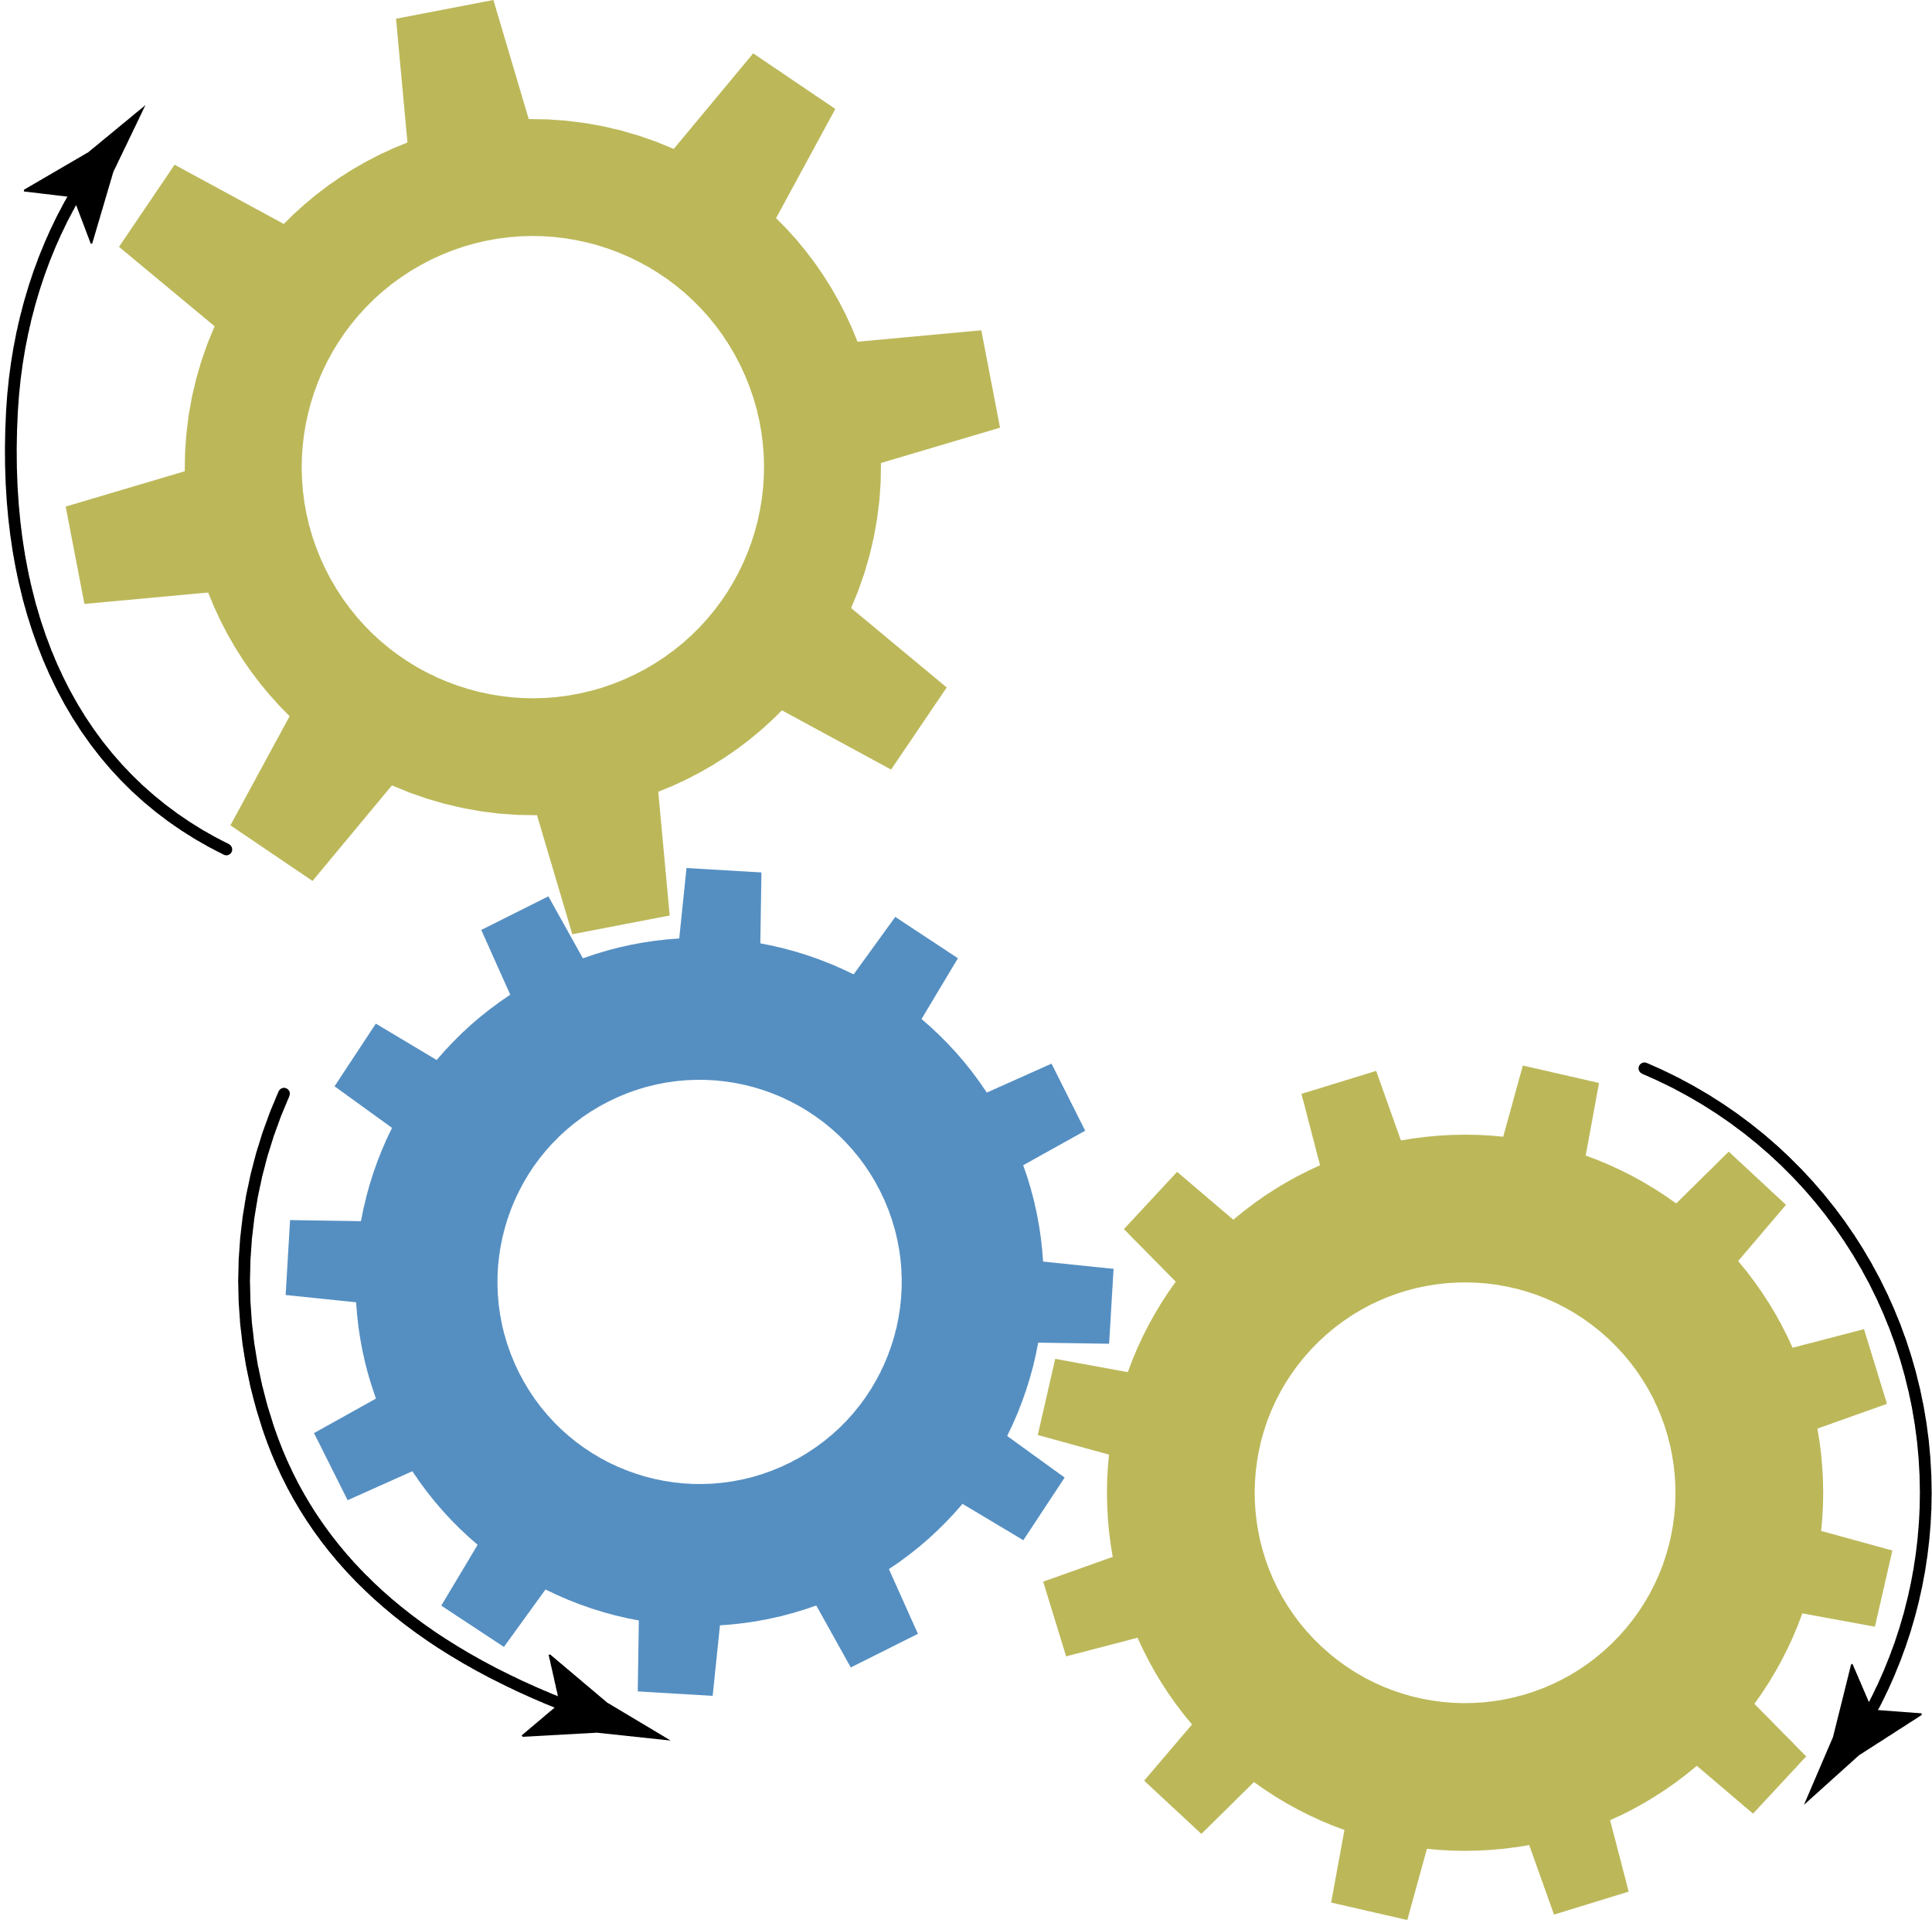

Process
The processes begin with the acquisition of images from the patients and these images are turned into a data set. In order to obtain the data set, microscopic images of the bone marrow and blood is collected from healthy, and leukemia diagnosed patients. After this process, the obtained data sets are subjected to several preprocessing processes to improve their quality. Finally, the classification step will take place.

Slide 11

Process
In this study, unlike the studies in the literature for computer-assisted diagnosis of acute lymphoblastic leukemia through microscopic blood images, different preprocessing techniques, 10-fold cross validation different pre-trained networks and ensemble learning techniques combined to investigate the effect of different approaches on performance.

Slide 12


Datasets
ALL-IDB dataset, used for segmentation and classification algorithms in diagnostic systems for Acute Lymphoblastic Leukemia. It includes two subtypes: ALL-IDB1 with full images at different magnifications and ALL-IDB2 with cropped images of single cells. The study focused on ALL-IDB1.
Notes:
Open access datasets that can be used for the diagnosis of acute lymphoblastic leukemia can be listed as ASH and ALL-IDB.
The dataset to be used in this study is the ALL-IDB dataset. It is prepared by Università degli Studi di Milano for the development of segmentation and classification algorithms in lymphoblastic leukemia diagnostic systems. ALL-IDB dataset has two subtypes they are ALL-IDB1 and ALL-IDB2. Main difference between those two is the ALL_IDB1 dataset contains full images of blood cells at different magnifications, while the ALL_IDB2 dataset consists of cropped images of single cells. We focused our studies on ALL-IDB1 dataset
All images in the content of the data set were evaluated by oncology specialists. Captured with optical laboratory microscopes. Images are in JPG format and have 24-bit color depth. The resolution of the images is 2592 x 1944 pixels.

Slide 13

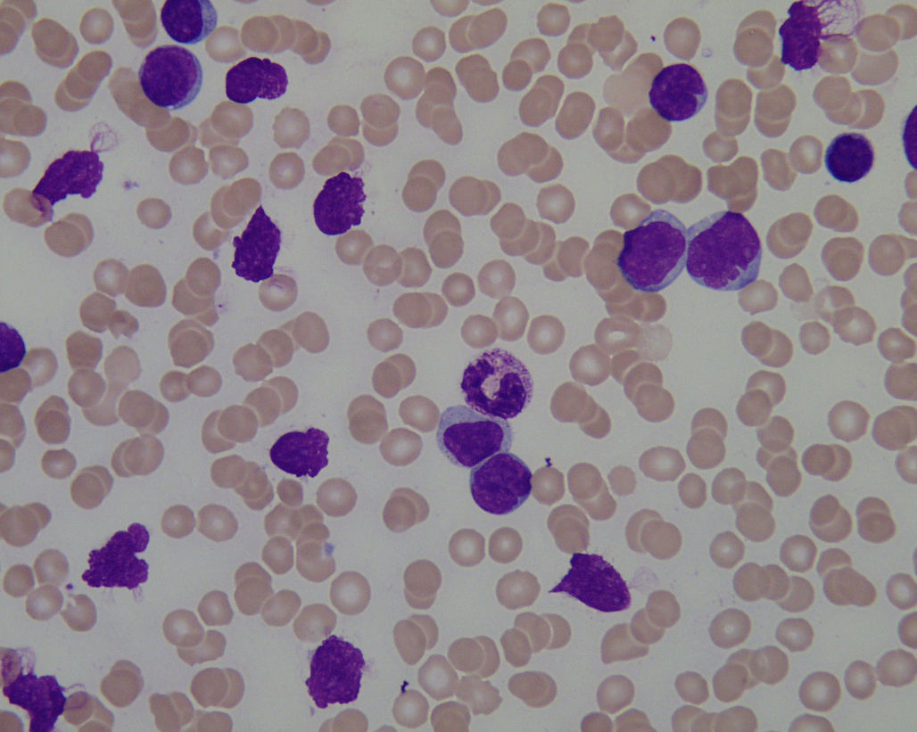
ALL-IDB 1
This dataset is composed of 108 images collected during September, 2005. It contains about 39000 blood elements, where the lymphocytes has been labeled by expert oncologists. The images are taken with different magnifications of the microscope ranging from 300 to 500.

Slide 14

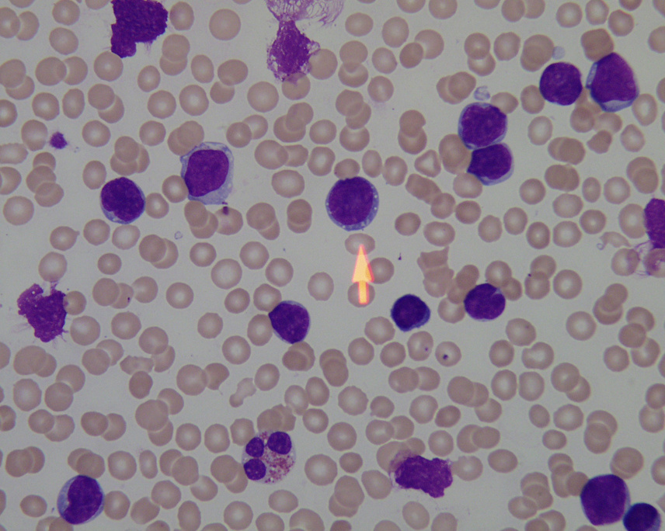
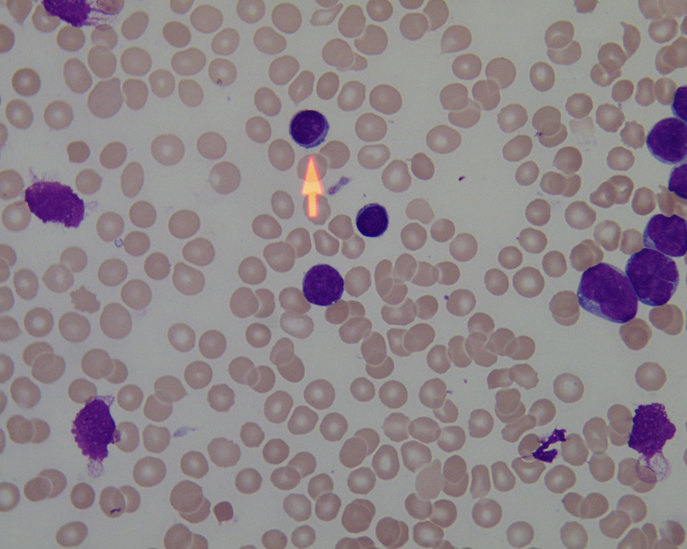
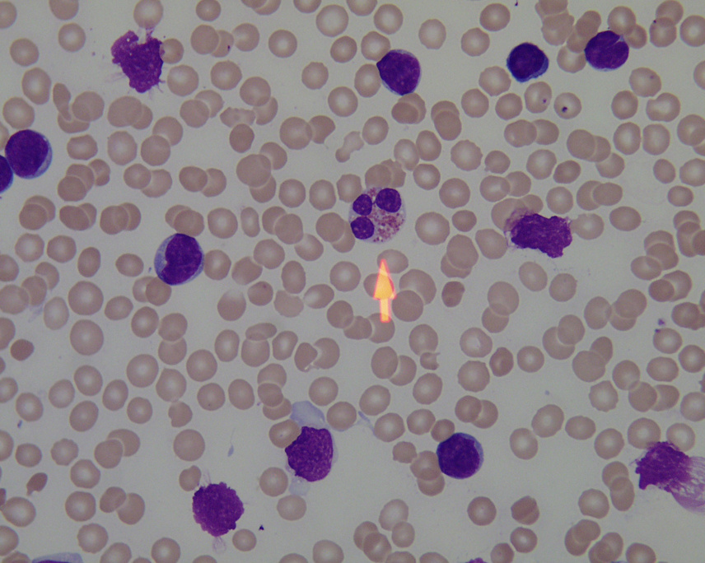
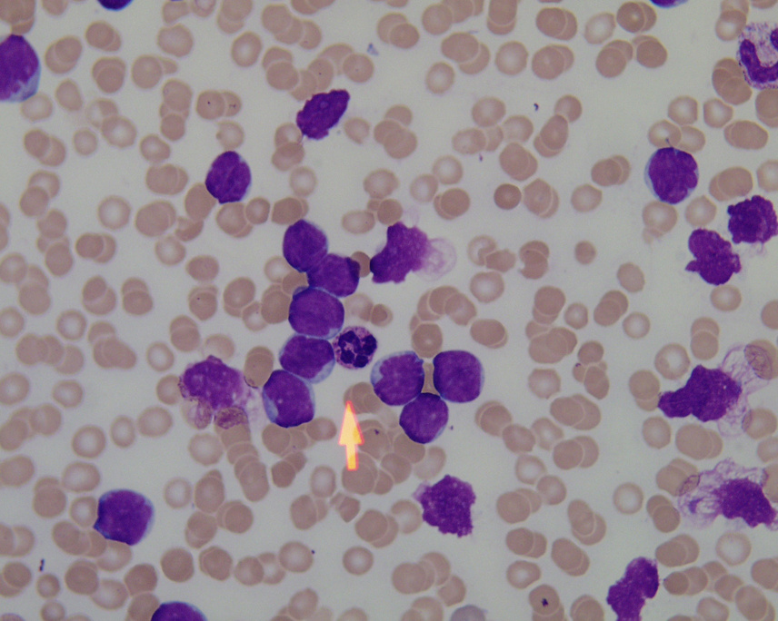
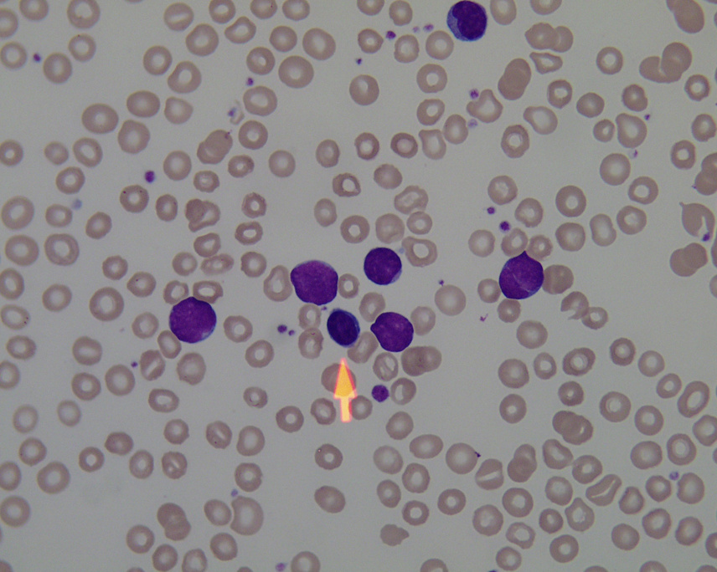
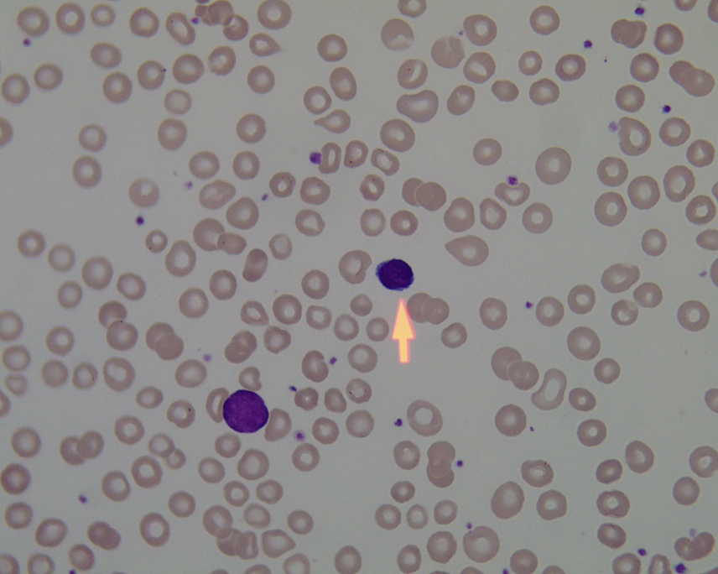

Slide 15






Preprocessing Techniques
Convolutional Neural Networks
Methods
Transfer Learning
K-Fold Cross Validation
Ensemble Learning

Slide 16
Preprocessing Techniques
Some preprocessing methods have been applied to the data set in order to achieve the goal and increase the accuracy of the model. The suggested results to achieve positive results by improving the overall performance of the system are in the list below:
Resize Images: To work with images, we need to resize them according to the input layers of the defined mesh.
Data Augmentation: It involves the various transformations required, such as rotating, rotating, and mirroring images in the dataset. In this step, the image in the training set is increased.

Slide 17
K-Fold Cross Validation
K-fold Cross Validation is a validation method to evaluate the performance of the machine learning model, which divides the data set into K equal parts and measures the overall performance by using each part in turn as test data. Detects overfitting problem. It also increases the generalization ability of the model and better fits real-world data.

Slide 18
Convolutional Neural Networks
Convolutional neural networks (CNNs) are a type of neural network designed specifically for image processing and computer vision tasks. They are composed of multiple layers of interconnected "neurons" that process and analyze the input data.

Slide 19
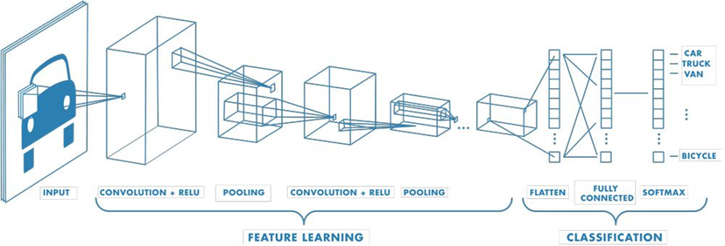
Convolutional Neural Networks
Notes:
Input Layer: represents the data
Convolution layer: applies convolutional filters to input data to extract features
ReLU Layer (activation layer): filters out non-activated features
Pooling Layer: simplifies output and reduces number of parameters
Flatten Layer: reduces data to one dimension and creates feature vector
Fully-connected Layer: performs classification based on feature vector
Softmax layer: calculates classification and error rate

Slide 20
Transfer Learning
Transfer Learning allows the knowledge gained from solving one task to be used to solve a related task. It involves using a pre-trained model or learned features as a starting point and fine-tuning or adapting them to the new task. Also, it can improve model performance and reduce training time.
Outline of the process of implementing transfer learning:
Select and load a pre-trained network into the system.
Adjust the last fully connected layer and the last classification layer to fit the new data set and replace them with new ones.
Divide the data set into training and test sets and set the training options using the training set.
Measure the performance of the system using the test set.

Slide 21
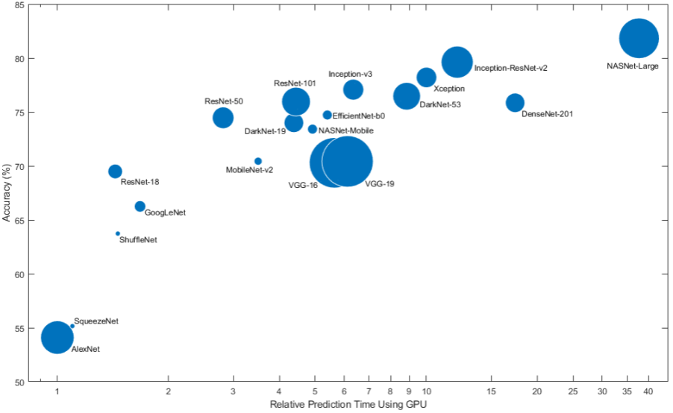
Transfer Learning
Notes:
Input Layer: represents the data
Convolution layer: applies convolutional filters to input data to extract features
ReLU Layer (activation layer): filters out non-activated features
Pooling Layer: simplifies output and reduces number of parameters
Flatten Layer: reduces data to one dimension and creates feature vector
Fully-connected Layer: performs classification based on feature vector
Softmax layer: calculates classification and error rate

Slide 22
Ensemble Learning
Ensemble learning is a machine learning technique that involves combining the predictions of multiple models to make a final prediction. The goal of ensemble learning is to improve the performance of the model by leveraging the strengths of multiple models and reducing the impact of individual model biases or errors.
In this study the following Ensemble Learning method applied:
Stacking: creates a new model using the results of previous models

Slide 23
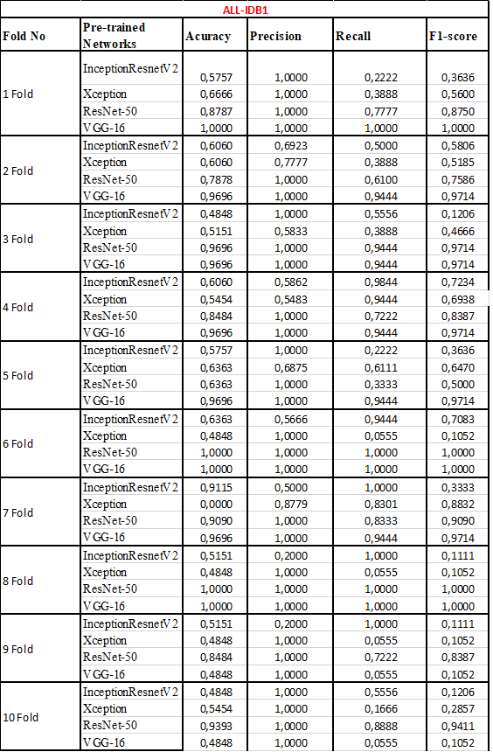
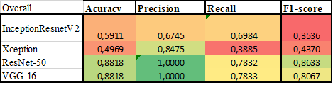
Experimental Results of original dataset.

Slide 24
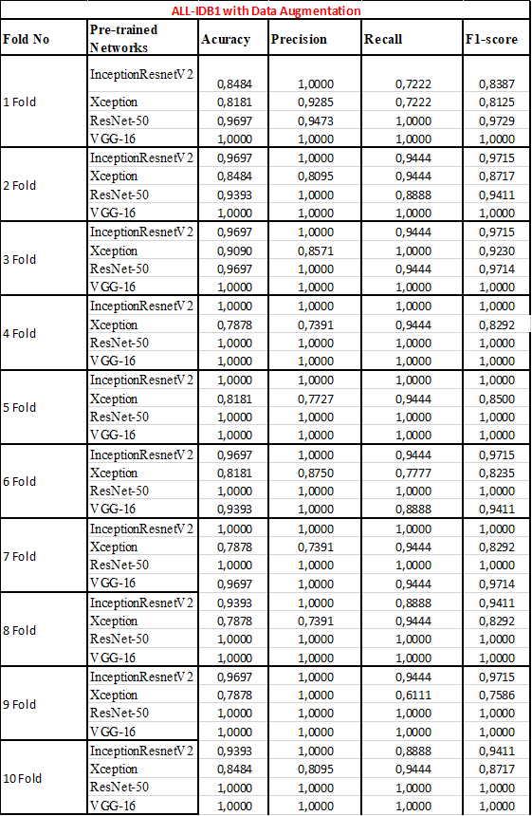
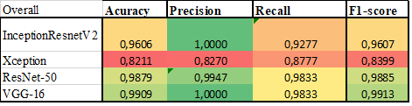
Experimental Results of augmented dataset.

Slide 25
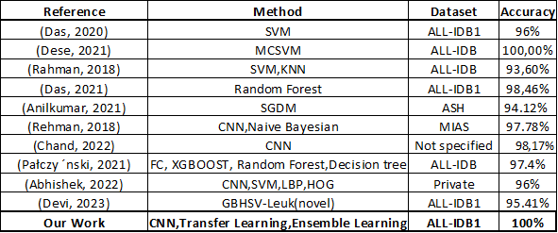
Results in the Literature
In the literature the classification accuracy rate of ALL is from 93,60% to 100% and this study achieved 100% accuracy with using a new approach.

Slide 26
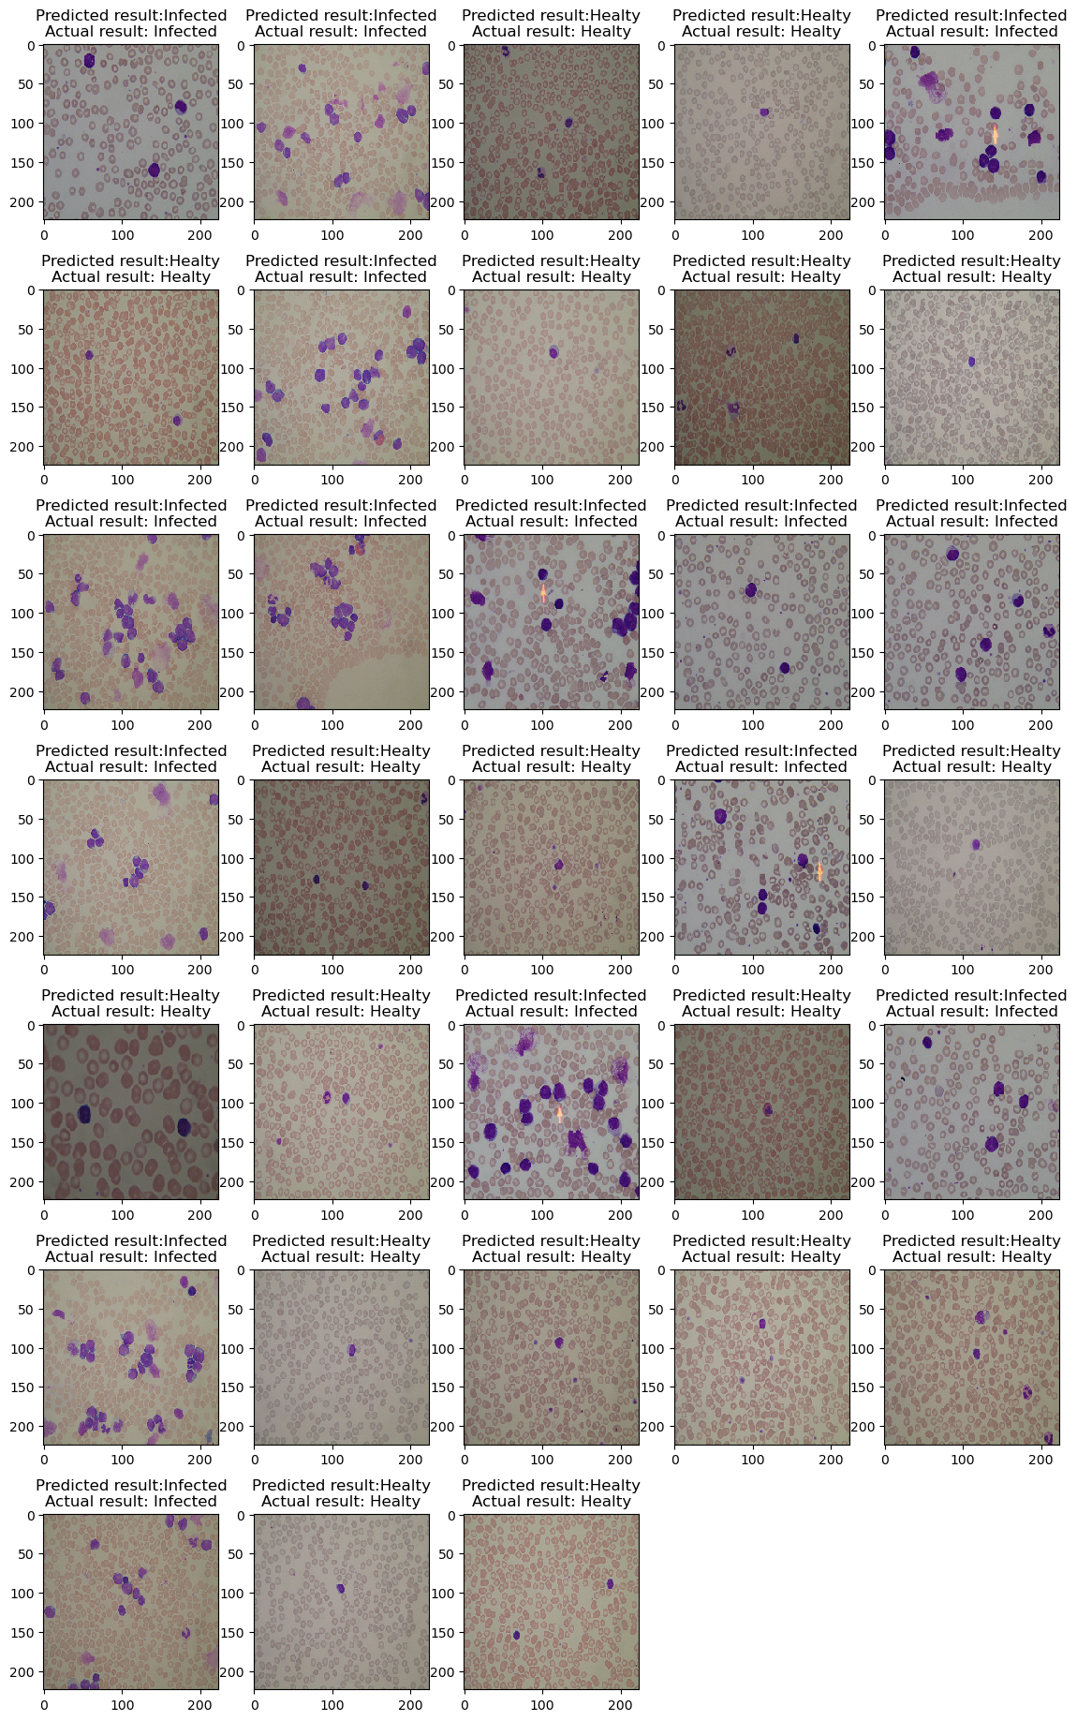
Test set results

Slide 27

Conclusion
As a result, a classification and diagnostic model has been developed for the diagnosis of Acute Lymphoblastic Leukemia using different methods. In this context, it is planned to be used to provide a second opinion to healthcare personal for the detection of this disease and to increase the accuracy of the diagnosis. Finally using ensemble learning method 100% accuracy achieved.It is planned to repeat the experiments by adding subclasses(T-ALL, B-ALL and Burkitt lymphoma(BL)) of leukemia disease in the data set.For the next step we are planning to write an article about our project and publish it.

Slide 28


